Slide 1
Operating Systems Sub Code:18CS43 Process Synchronization
Faculty Name : Sougandhika Narayan
Asst. Professor, Department of CSE
KSIT, Bangalore

Slide 2
Process Synchronization
Basic Concepts
Scheduling Criteria
Scheduling Algorithms
Thread Scheduling
Multiple-Processor Scheduling
Real-Time CPU Scheduling
Operating Systems Examples
Algorithm Evaluation

Slide 3
Objectives
To introduce CPU scheduling, which is the basis for multiprogrammed operating systems
To describe various CPU-scheduling algorithms
To discuss evaluation criteria for selecting a CPU-scheduling algorithm for a particular system
To examine the scheduling algorithms of several operating systems

Slide 4
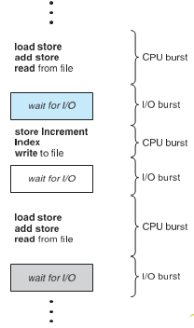
Basic Concepts
Maximum CPU utilization obtained with multiprogramming
CPU–I/O Burst Cycle – Process execution consists of a cycle of CPU execution and I/O wait
CPU burst followed by I/O burst
CPU burst distribution is of main concern

Slide 5
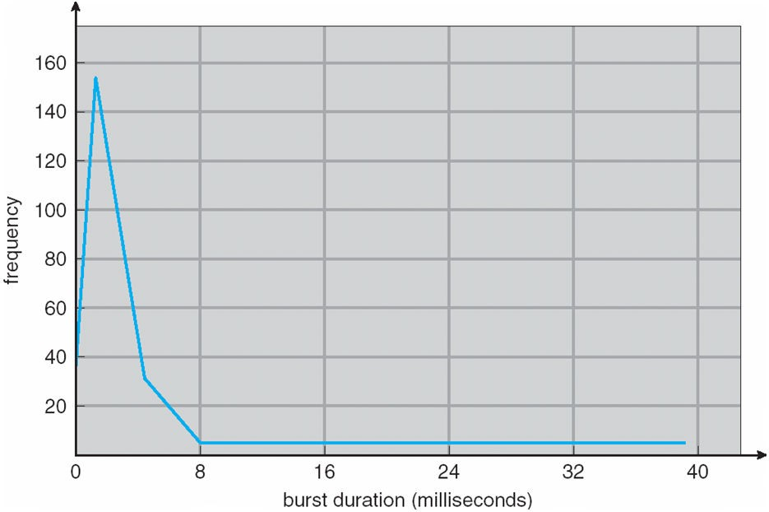
Histogram of CPU-burst Times
Typically large number of short CPU bursts and a small number of long CPU bursts An I/O-bound program typically has many short CPU bursts.
A CPU-bound program might have a few long CPU bursts.

Slide 6
CPU Scheduler
Short-term scheduler selects from among the processes in ready queue, and allocates the CPU to one of them
Queue may be ordered in various ways
CPU scheduling decisions may take place when a process:
Switches from running to waiting state
Switches from running to ready state
Switches from waiting to ready
Terminates
Scheduling under 1 and 4 is nonpreemptive
All other scheduling is preemptive
Consider access to shared data
Consider preemption while in kernel mode
Consider interrupts occurring during crucial OS activities

Slide 7
Preemptive Process Scheduling
is based on priority where a scheduler may preempt a low priority running process anytime when a high priority process enters into a ready state.
Incurs a cost associated with access to shared data.

Slide 8
Non-Preemptive Process Scheduling
Also called as Cooperative scheduling
Once the CPU has been allocated to a process, the process keeps the CPU until it releases the CPU either by terminating or by switching to the waiting state.
algorithms are designed so that once a process enters the running state, it cannot be preempted until it completes its allotted time

Slide 9
Dispatcher
Dispatcher module gives control of the CPU to the process selected by the short-term scheduler; this involves:
switching context
switching to user mode
jumping to the proper location in the user program to restart that program
Dispatch latency – time it takes for the dispatcher to stop one process and start another running

Slide 10
Scheduling Criteria
CPU utilization – keep the CPU as busy as possible
Throughput – # of processes that complete their execution per time unit
Turnaround time – amount of time to execute a particular process
Waiting time – amount of time a process has been waiting in the ready queue
Response time – amount of time it takes from when a request was submitted until the first response is produced, not output (for time-sharing environment)

Slide 11
Scheduling Algorithm Optimization Criteria
Max CPU utilization
Max throughput
Min turnaround time
Min waiting time
Min response time

Slide 12
Process Scheduler
schedules different processes to be assigned to the CPU based on particular scheduling algorithms. There are six popular process scheduling algorithms which are :
First-Come, First-Served (FCFS) Scheduling
Shortest-Job-First (SJF) Scheduling
Priority Scheduling
Shortest Remaining Time First
Round Robin(RR) Scheduling
Multiple-Level Queues Scheduling

Slide 13
First Come First Serve (FCFS)
Jobs are executed on first come, first serve basis.
It is a non-preemptive, pre-emptive scheduling algorithm.
Easy to understand and implement.
Its implementation is based on FIFO queue.
Poor in performance as average waiting time is high.

Slide 14
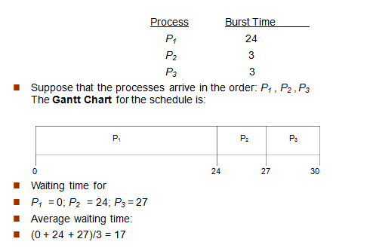
First-Come, First-Served (FCFS) Scheduling

Slide 15
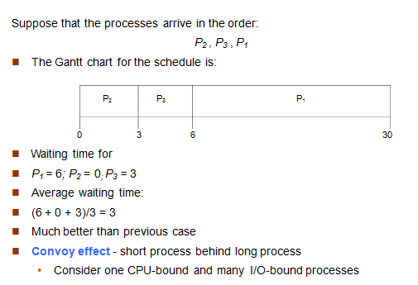
FCFS Scheduling (Cont.)

Slide 16
Shortest-Job-First (SJF) Scheduling
Associate with each process the length of its next CPU burst
Use these lengths to schedule the process with the shortest time
SJF is optimal – gives minimum average waiting time for a given set of processes
The difficulty is knowing the length of the next CPU request
Could ask the user

Slide 17
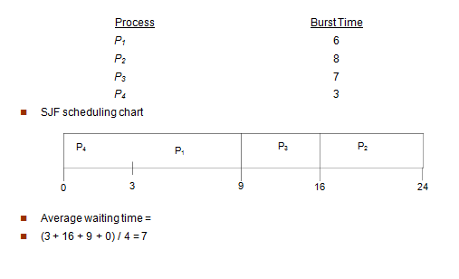
Example of SJF

Slide 18
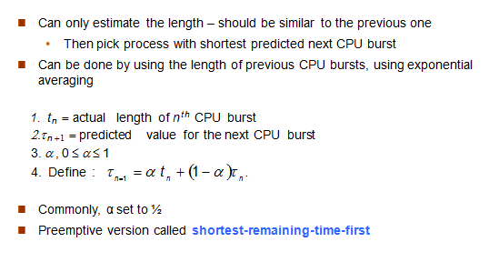
Determining Length of Next CPU Burst

Slide 19
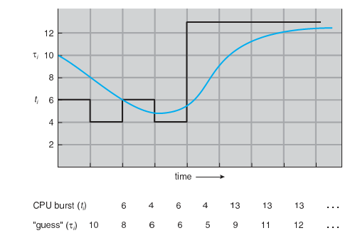
Prediction of the Length of the Next CPU Burst

Slide 20
Examples of Exponential Averaging
α =0
τ_{n+1} = τ_{n}
Recent history does not count
α =1
τ_{n+1} = α t_{n}
Only the actual last CPU burst counts
If we expand the formula, we get:
τ_{n+1} = α t_{n}+(1 - α)α t_{n} -1 + …
+(1 - α )^{j} α t_{n -j} + …
+(1 - α )^{n +1} τ₀
Since both α and (1 - α) are less than or equal to 1, each successive term has less weight than its predecessor

Slide 21
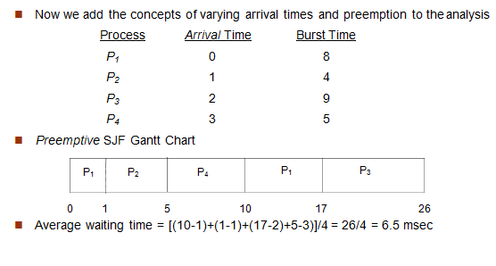
Example of Shortest-remaining-time-first

Slide 22
Priority Scheduling
A priority number (integer) is associated with each process
The CPU is allocated to the process with the highest priority (smallest integer ≡
highest priority)
Preemptive
Nonpreemptive
SJF is priority scheduling where priority is the inverse of predicted next CPU burst time
Problem ≡ Starvation – low priority processes may never execute
Solution ≡ Aging – as time progresses increase the priority of the process

Slide 23
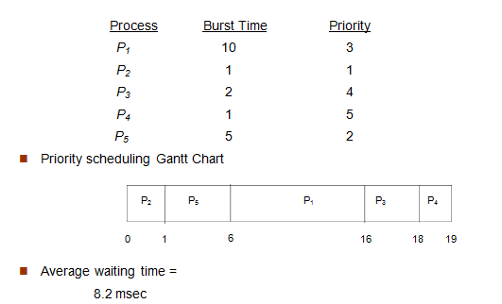
Example of Priority Scheduling

Slide 24
Round Robin (RR)
Each process gets a small unit of CPU time (time quantum q), usually 10-100 milliseconds. After this time has elapsed, the process is preempted and added to the end of the ready queue.
If there are n processes in the ready queue and the time quantum is q, then each process gets 1/n of the CPU time in chunks of at most q time units at once. No process waits more than (n-1)q time units.
Timer interrupts every quantum to schedule next process
Performance
q large ⇒ FIFO
q small ⇒ q must be large with respect to context switch, otherwise overhead is too high

Slide 25
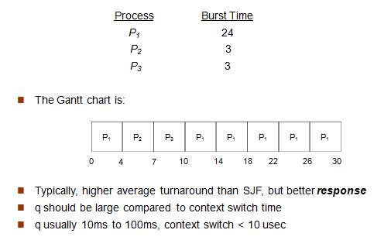
Example of RR with Time Quantum = 4

Slide 26
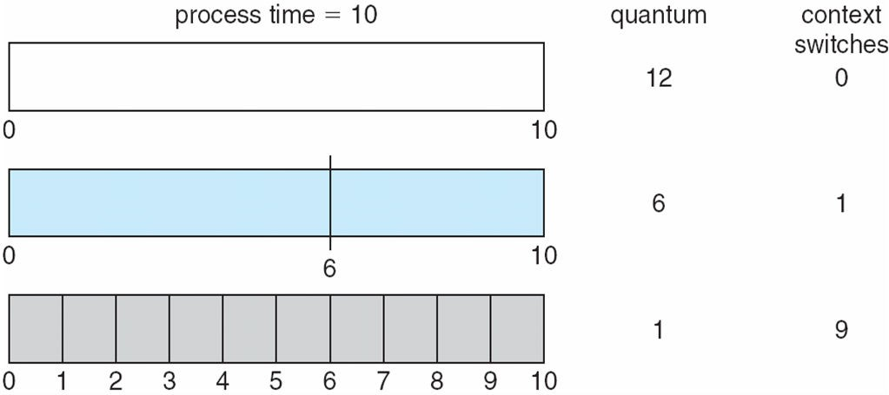
Time Quantum and Context Switch Time

Slide 27
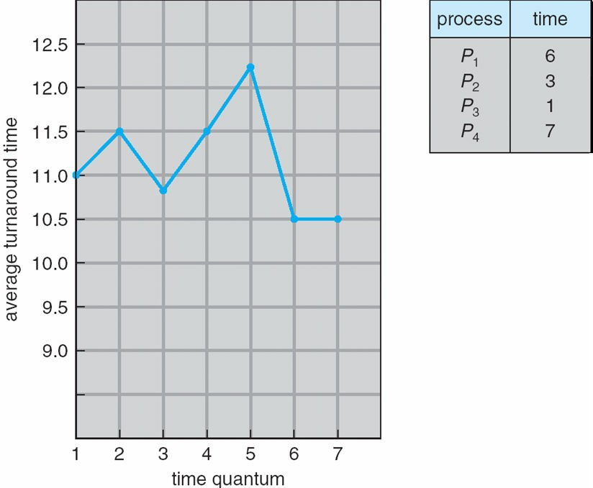
Turnaround Time Varies With The Time Quantum
80% of CPU bursts should be shorter than q

Slide 28
Multilevel Queue

